Slide 1

Applied Physics
Lab:05
Instructor:Engr. Asif Ali
B.E(CS) QUEST) Nawab Shah
MS(CS), SIBAU
Engr. Asif Ali

Slide 2
Agenda
Active & Passive elements
Capacitor
How capacitor works
Types of materials used in capacitors
Capacitors in Series
Capacitors in Parallel
Engr. Asif Ali

Slide 3
Objective
The objective of this Lab is to understand the series and parallel connections of the capacitors.
Engr. Asif Ali

Slide 4
Active and Passive elements
Active Elements: An active component is an electronic component which supplies energy to a circuit.
Example: Generator and Batteries
Passive Elements:
A passive component is an electronic component which can only receive energy, which it can either absorb or store it in an electric field or a magnetic field. Passive elements do not need any form of electrical power to operate.
Example:
Resistors-Inductors-Capacitors-Transformers
Engr. Asif Ali

Slide 5
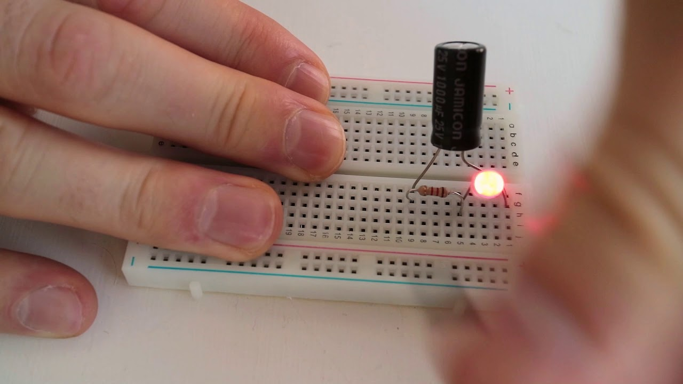
Capacitor

Slide 6
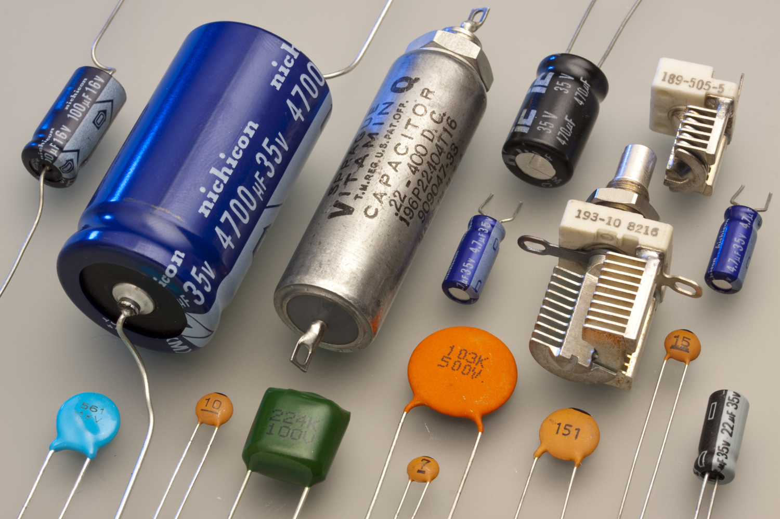
Capacitors

Slide 7
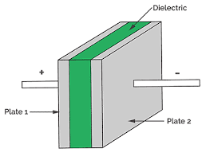
Capacitor
Capacitors are simple passive device that can store an electrical charge on their plates when connected to a voltage source.
In its basic form, a capacitor consists of two conductive (metal) plates which are not connected or touching each other, but are electrically separated either by air or by some form of a good insulating material such as waxed paper, mica, ceramic, plastic or some form of a liquid gel as used in electrolytic capacitors.
The insulating layer between a capacitors plates is commonly called the Dielectric.
Engr. Asif Ali

Slide 8
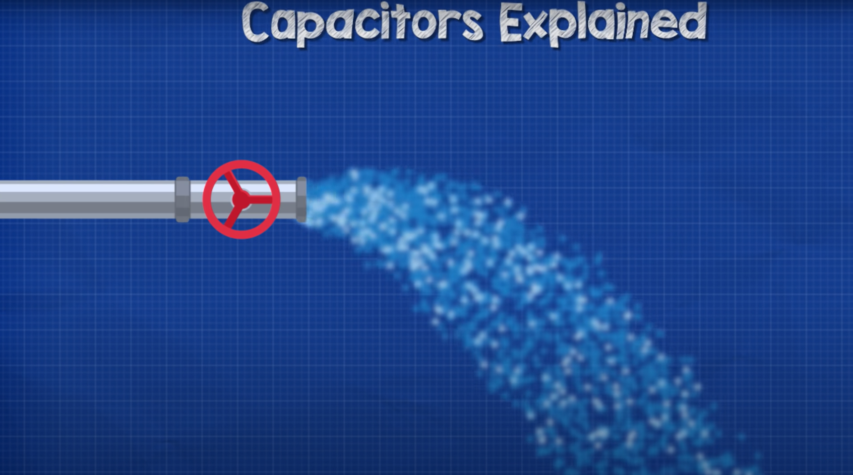
How capacitor works?
Engr. Asif Ali

Slide 9
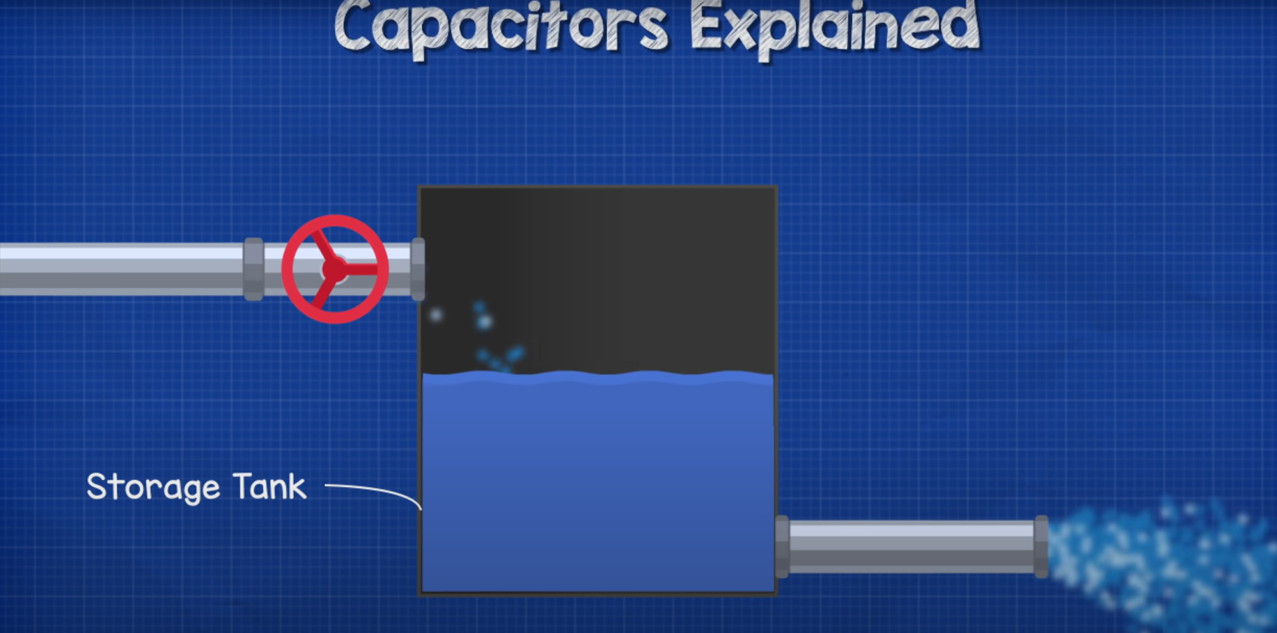
How capacitor works?
Engr. Asif Ali

Slide 10
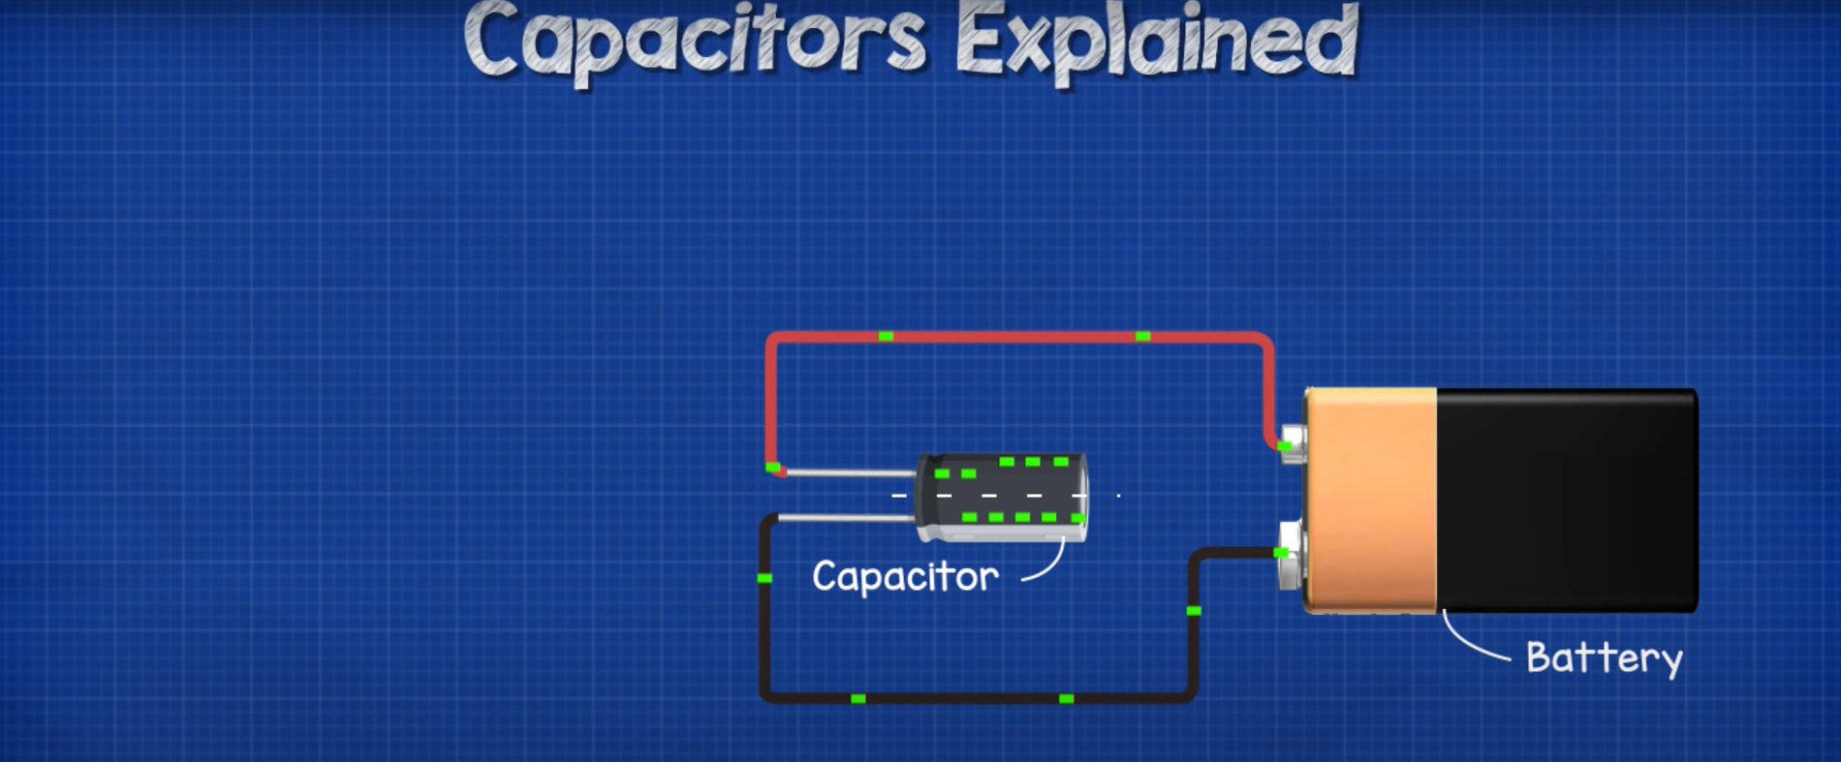
How capacitor works?
Engr. Asif Ali

Slide 11
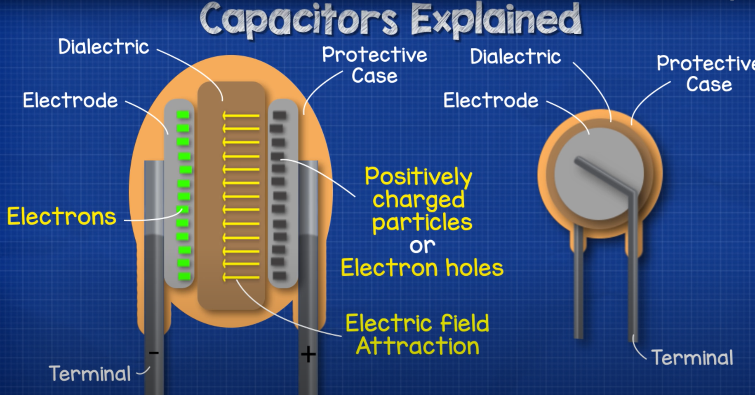
How capacitor works?
Engr. Asif Ali

Slide 12
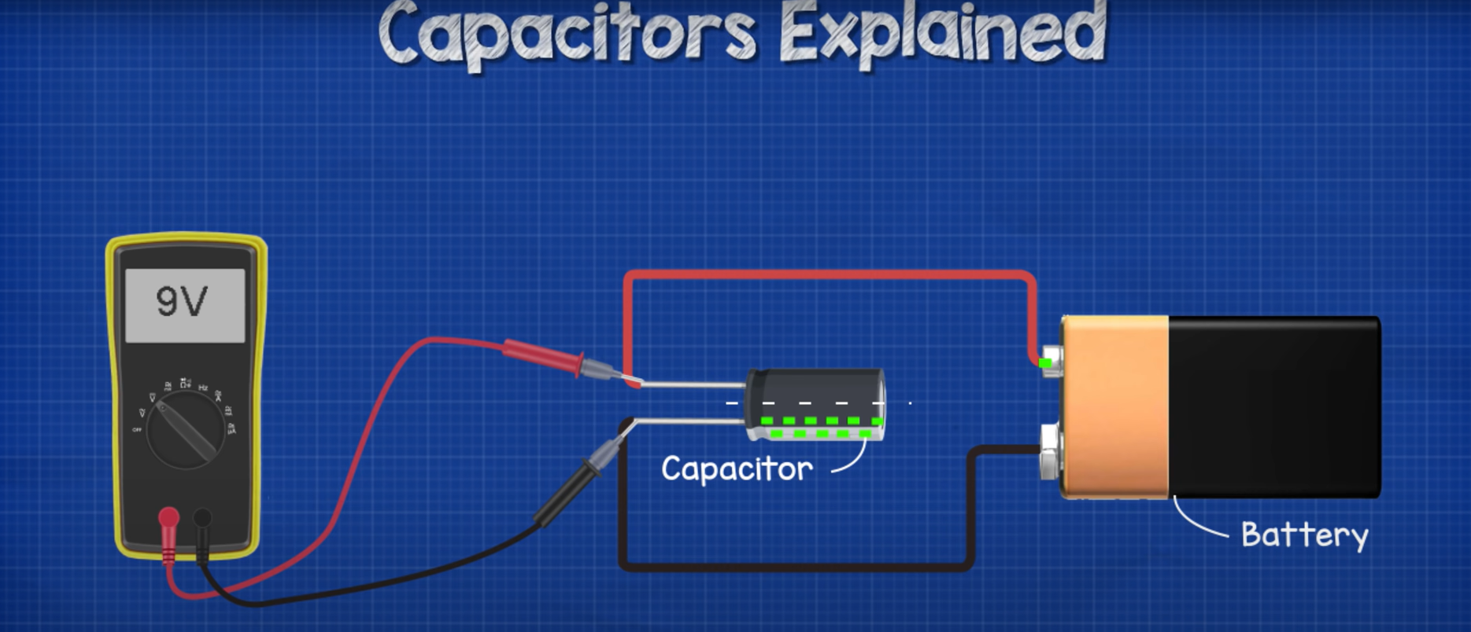
Meassuring Voltages of Capacitor
Engr. Asif Ali

Slide 13
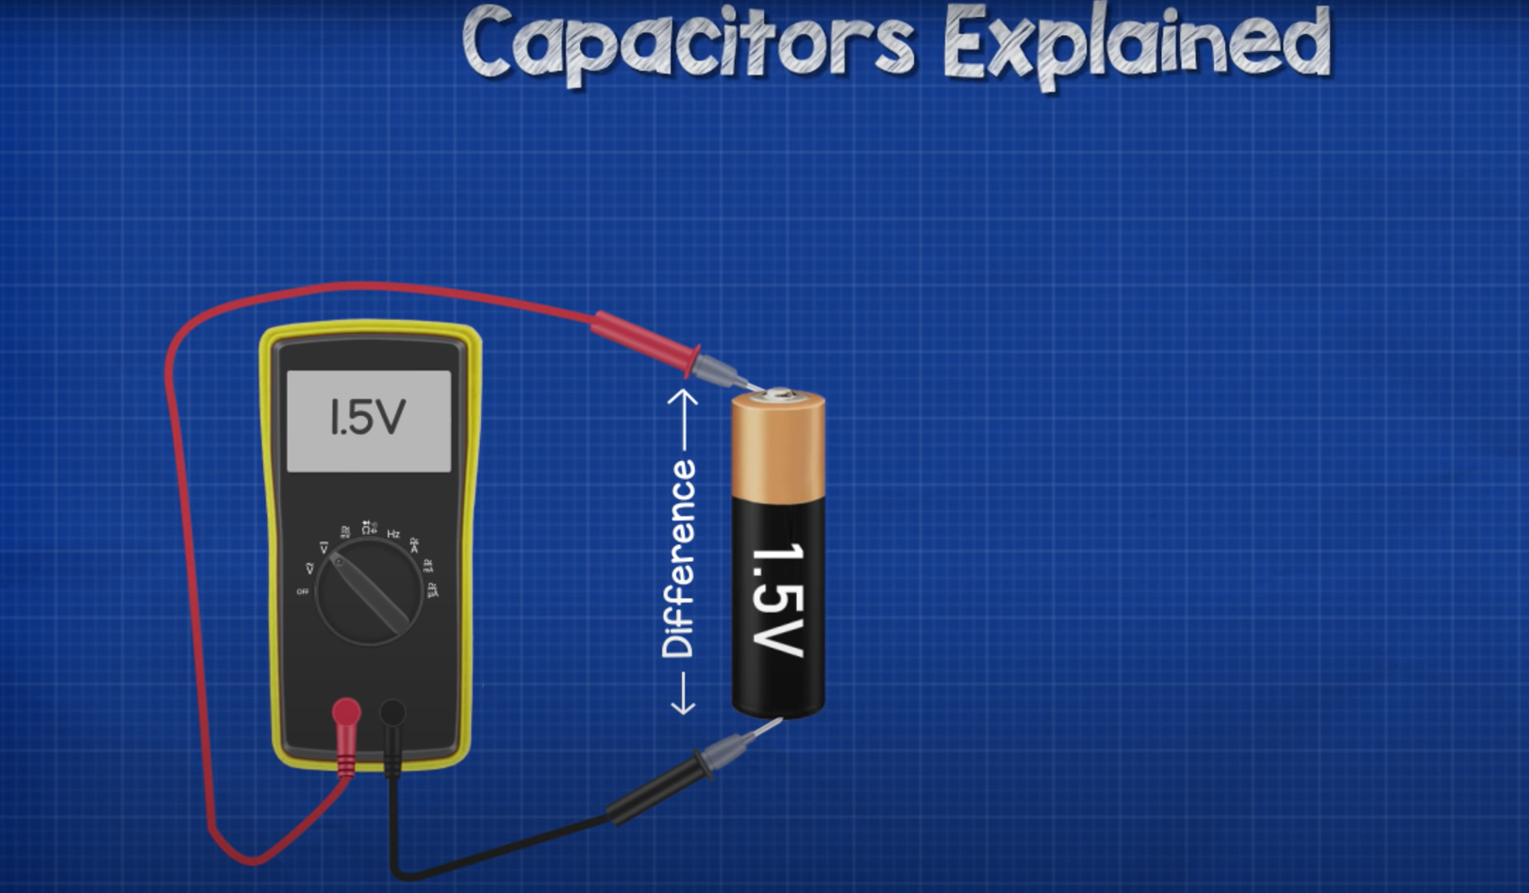
Meassuring Voltages
Engr. Asif Ali

Slide 14
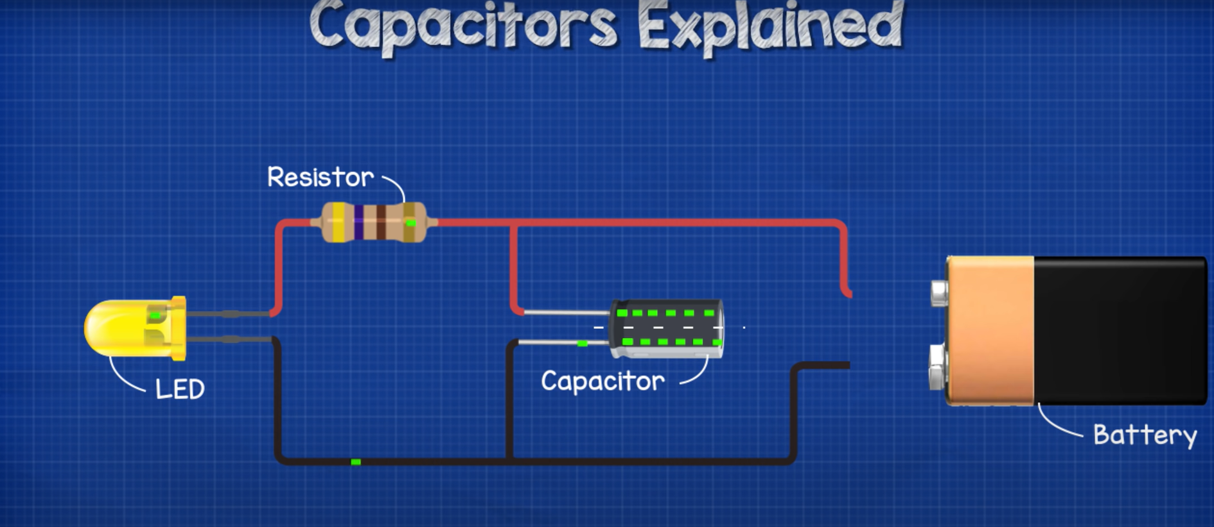
How Capacitor works?
Engr. Asif Ali

Slide 15
Types of materials used in Capacitors
Ceramic Capacitors
Film Capacitors
Power Film Capacitors
Electrolytic Capacitors
Ceramic capacitors
Film capacitors
Paper capacitors
Electrolytic capacitors
Engr. Asif Ali

Slide 16
Applications of Capacitors
Used in larged building for maintaining power factor
Used in conversion from AC to DC power.

Slide 17
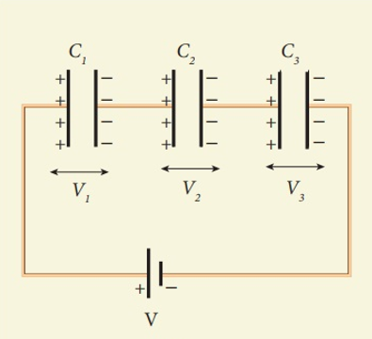
Capacitors in Series:
For series connected capacitors, the charging current ( iC ) flowing through the capacitors is the same for all capacitors as it only has one path to follow.
Then, Capacitors in Series all have the same current flowing through them as iT = i1 = i2 = i3 etc.
Therefore each capacitor will store the same amount of electrical charge, Q on its plates regardless of its capacitance.
Q_{T} = Q₁ = Q₂ = Q₃
Engr. Asif Ali

Slide 18
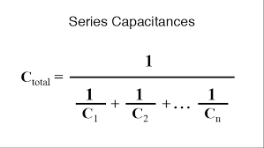
Capacitors in Series:
Engr. Asif Ali

Slide 19
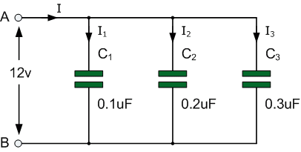
Capacitors in Parallel:
For parallel connected capacitors, the charging current ( iC ) flowing through the capacitors is the different for all capacitors.
Then, Capacitors in Series all have the same voltages flowing through them as V_{T} = v1 = v2 = v3 etc.
Therefore each capacitor will store the different amount of electrical charge.
Q_{T} = Q₁+Q₂ +Q₃
C_{T} = C₁ + C₂ + C₃
Engr. Asif Ali

Slide 20
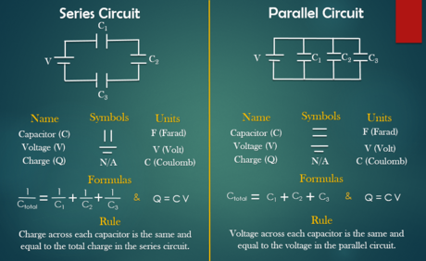
Engr. Asif Ali

Slide 21
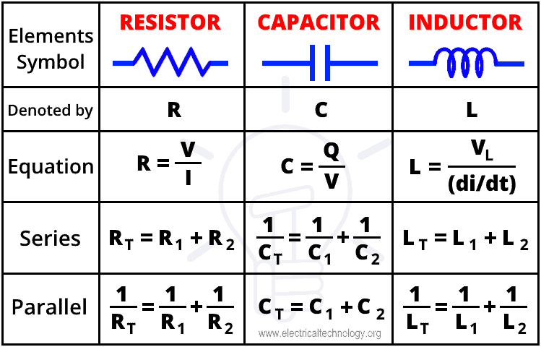

Slide 22
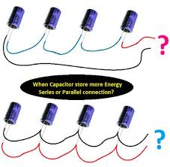
Capacitors in Series and Parallel circuit

Slide 23
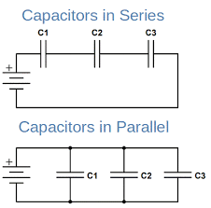
Series and Parallel circuit of Capacitors

Slide 24
Table used for Series Capacitors:
 | C1 (Larger Capacitance) | C2 (Smaller Capacitance) | Total Capacitance
Cmeas (µF)
ΔV (v)
Qcalc (µC)
Ecalc (µ J)
Engr. Asif Ali

Slide 25
Table used for Parallel Capacitors:
 | C1 (Larger Capacitance) | C2 (Smaller Capacitance) | Cp
Cmeas (µF)
ΔV (v)
Qcalc (µC)
Ecalc (µJ)
Engr. Asif Ali

Slide 26
Thank You
Engr. Asif Ali

